Slide 1
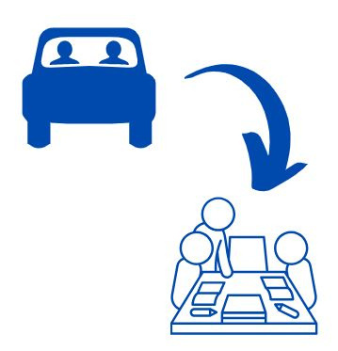

COLLABORIDE
DRIVE TOGETHER. DRIVE EFFICIENTLY. DRIVE SAFE.

Slide 2
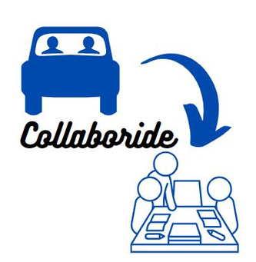
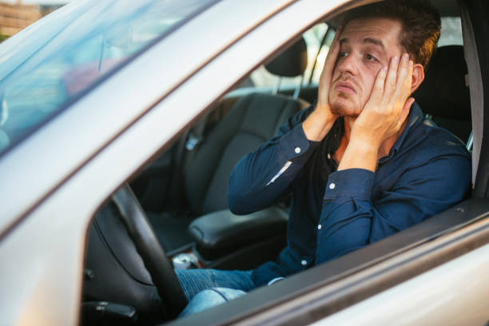
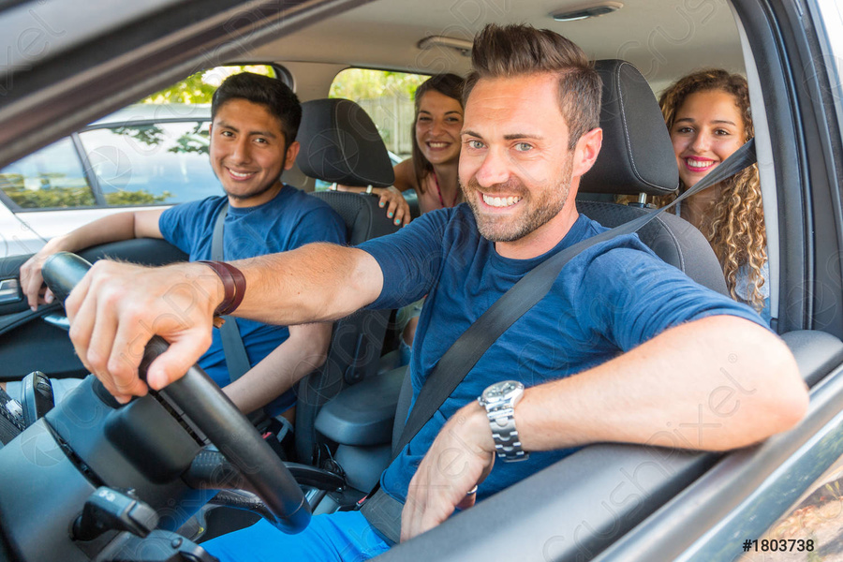
Use Collaboride!
this traffic jam is exhausting!

Slide 3
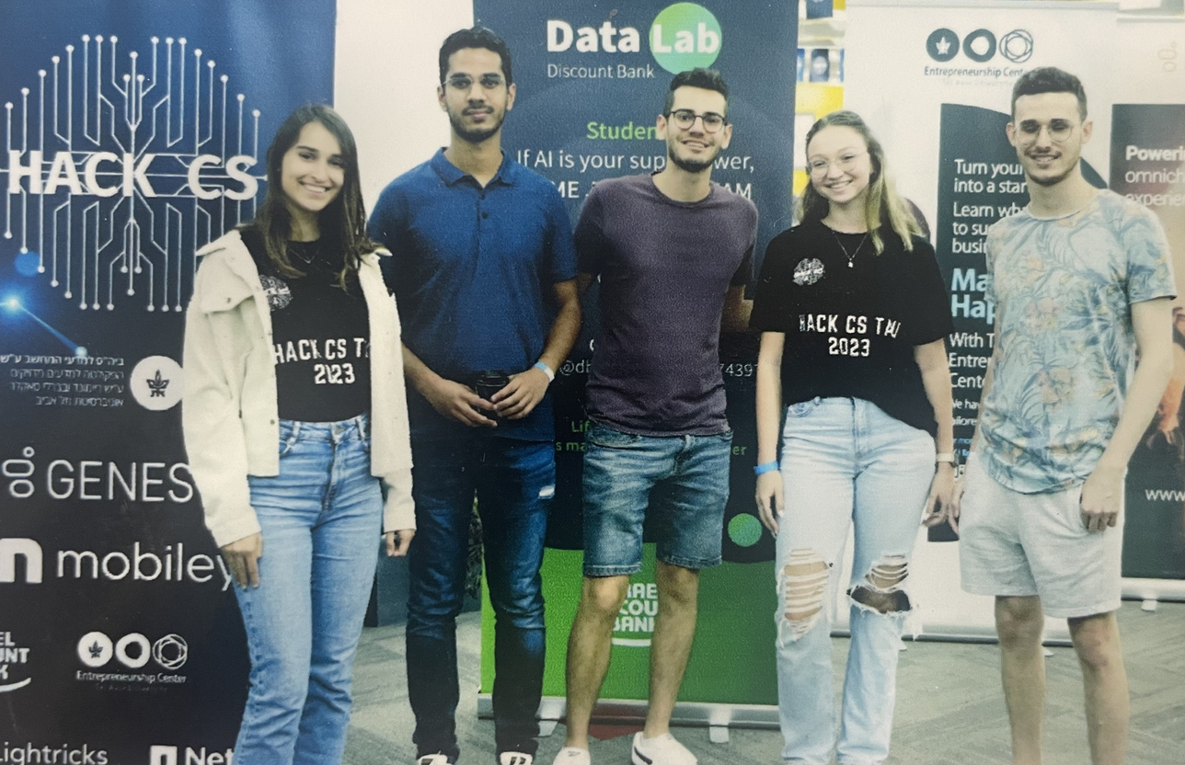
ABOUT US
WE ARE ALL STUDENTS IN TAU STUDYING COMPUTER SCIENCE, COMBINED WITH BIOINFORMATICS OR ECONOMY.
WE ALL WANT TO MAKE A POSITIVE CHANGE IN THE CITY'S EVERYDAY LIFE, THAT WILL CONTRIBUTE TO THE ENVIRONMENT, REDUCE TRAFFIC JAMS, AND CONNECT PEOPLE TOGETHER.
THERFORE, WE PRESENT "COLLABORIDE"

Slide 4
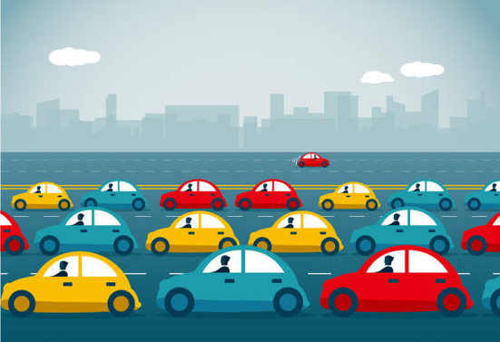


PROBLEM
Traffic jams lead to wasted time, increased stress levels, and decreased productivity for commuters
Cars' pollution contributes significantly to climate change and poor air quality, causing health issues and leading to global warming
People refrain from carpooling due to the fear and risks of driving alone with untrusted people

Slide 5
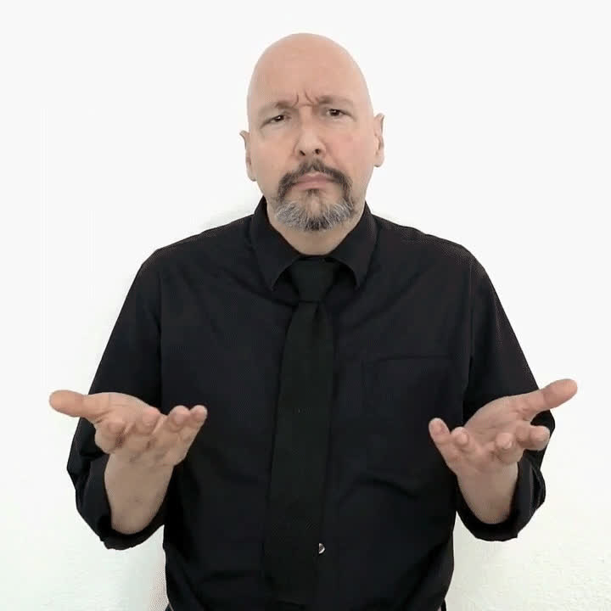
WHAT CAN WE DO?

Slide 6


CARPOOLING!
BUT...

Slide 7
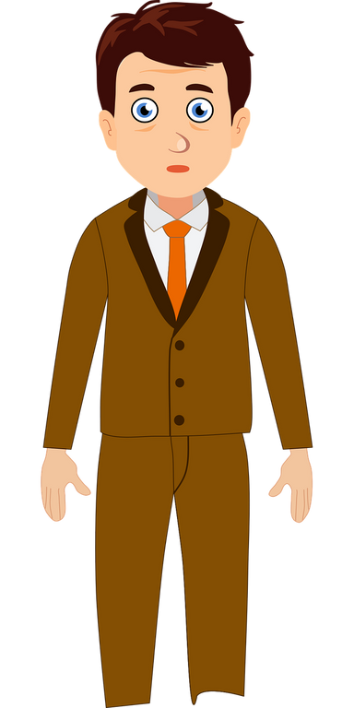
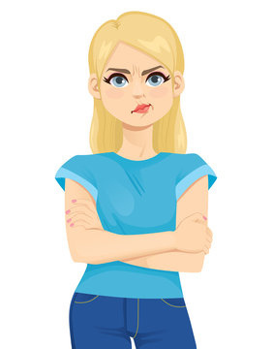

why would I share my car?
It's too difficult to plan my ride like this
I don't want to drive with complete strangers!

Slide 8
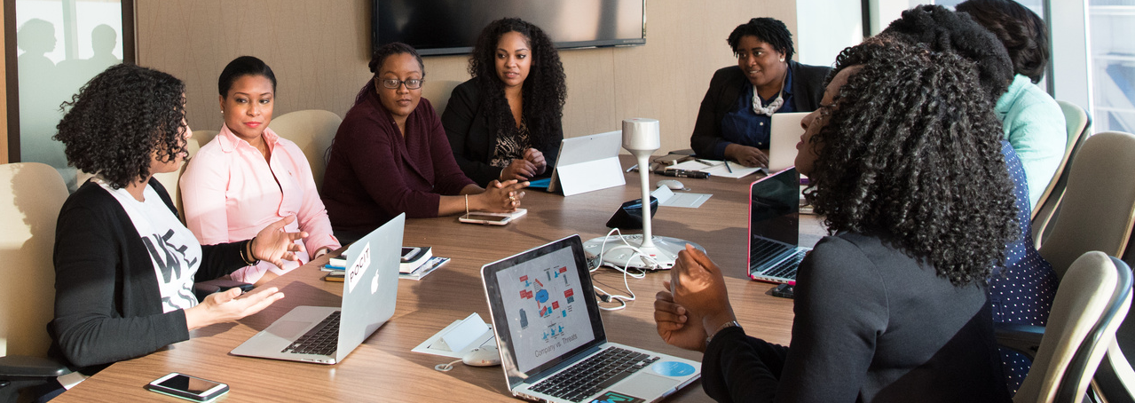
SOLUTION - COLLABORIDE
AS A COMPANY, CREATE A WORKSPACE FOR YOUR EMPLOYEES TO GET TOGETHER, CONNECT AND SHARE A RIDE TO WORK.
SUPPLY THEM A SAFE ENVIRONMENT TO COMMUTE AND COMMUNICATE.
ENHANCE THE COMPANY'S COMMUNALISM, WHILE SATISFYING YOUR NEEDS TO GET YOUR EMPLOYEES TO THE OFFICE EFFICIENTLY, SAVING CARS & CAR PARKINGS AND GAINING CALMER & MORE EFFICIENT EMPLOYEES.

Slide 9


OUR APP
1
FOR COMPANIES
Create a safe workspace for all your employees, where they can comfortably share
a ride together, connect, and get safely to work
2
FOR EMPLOYEES
Share your car and earn points, bond with trusted coworkers and gain new friends at your office, and drive fast on the drive-sharing lane
3
FOR THE CITY
Reduce traffic jams and air pollution, and create communities that can feel safe drive-sharing getting to work, and in every-day life

Slide 10



COMPETITION
Waze carpool does not prioritize safety and doesn't have organization's platform
All other competitors are not available for organizations in Israel and thus are not compatible with Israel's map nor language
Competitors doesn't have points-gain system to encourage car sharing

Slide 11
LIVE DEMO

Slide 12
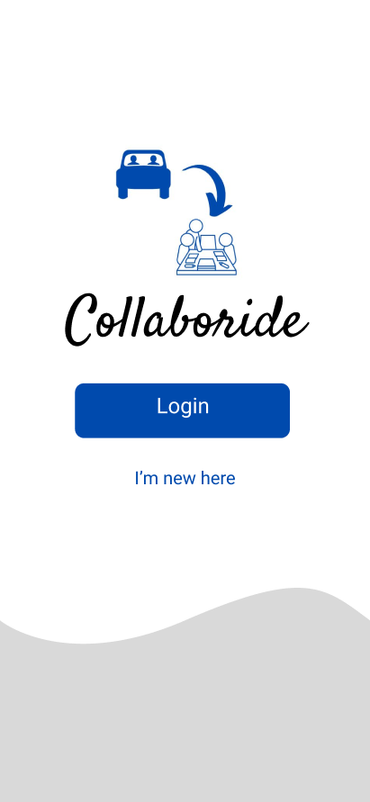
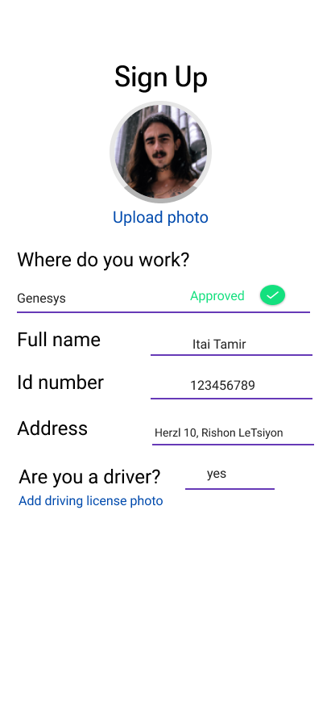
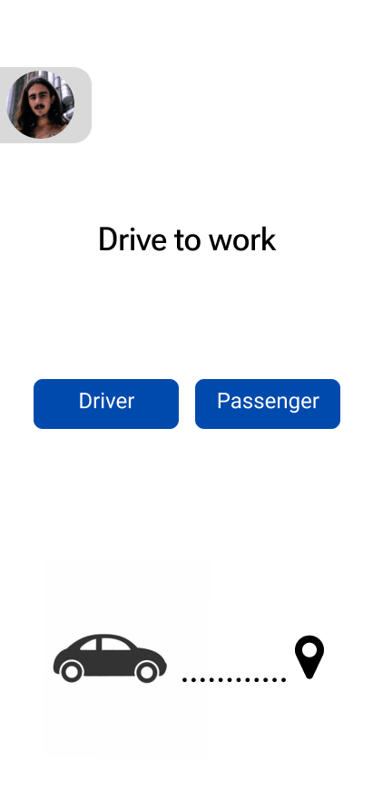
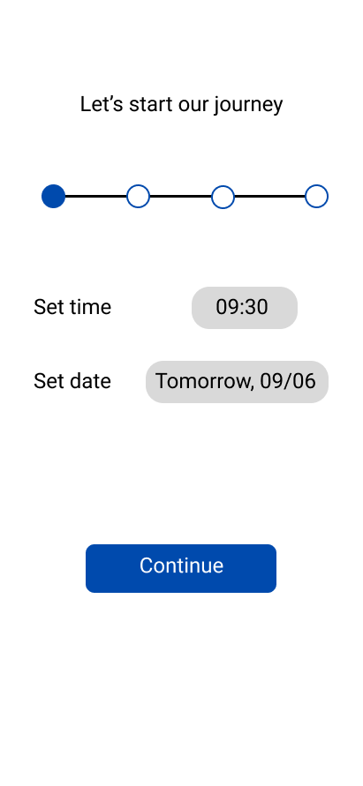
APP FLOW

Slide 13
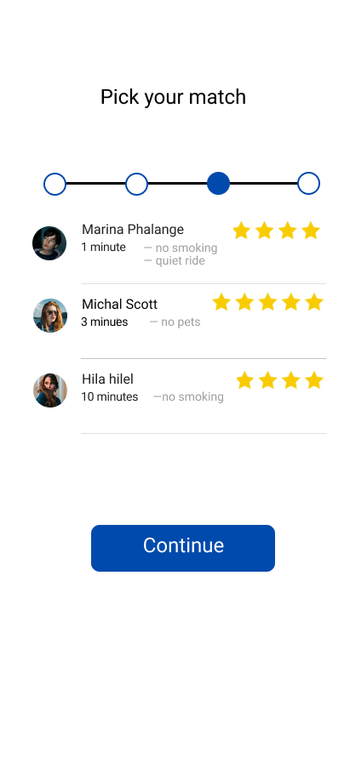
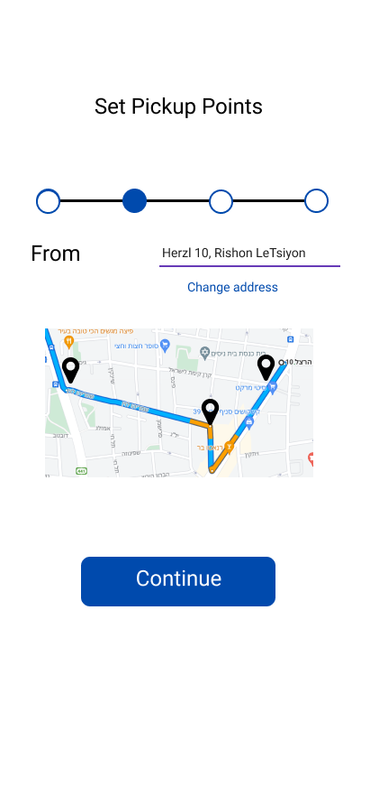
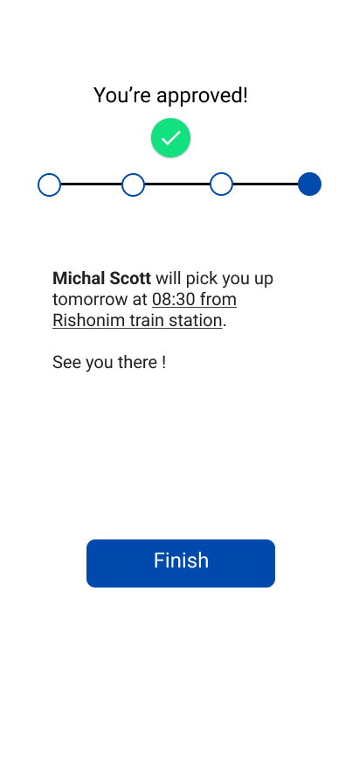
APP FLOW

Slide 14
FUTURE PLANS
EXPANDING
BIGGER CIRCLES
CREATING COMMUNITIES
Reaching colleges and universities to assist professors and students, reaching state-funded organizations, etc
Combining multiple organizations in the same area, in a safe and validated way, thus making the app more efficient for smaller companies
Commuters that got together using the app can build a community, and continue drive-sharing together outside their work scope

Slide 15

Thank You
and join Collaboride

